Slide 1
Philippians 4:1-9
Therefore, my brothers and sisters, you whom I love and long for, my joy and crown, stand firm in the Lord in this way, dear friends!
2 I plead with Euodia and I plead with Syntyche to be of the same mind in the Lord.

Slide 2
Philippians 4:1-9
3 Yes, and I ask you, my true companion, help these women since they have contended at my side in the cause of the gospel, along with Clement and the rest of my co-workers, whose names are in the book of life.

Slide 3
Philippians 4:1-9
4 Rejoice in the Lord always. I will say it again: Rejoice! 5 Let your gentleness be evident to all. The Lord is near

Slide 4
Philippians 4:1-9
6 Do not be anxious about anything, but in every situation, by prayer and petition, with thanksgiving, present your requests to God. 7 And the peace of God, which transcends all understanding, will guard your hearts and your minds in Christ Jesus.

Slide 5
Philippians 4:1-9
8 Finally, brothers and sisters, whatever is true, whatever is noble, whatever is right, whatever is pure, whatever is lovely, whatever is admirable—if anything is excellent or praiseworthy—think about such things.

Slide 6
Philippians 4:1-9
9 Whatever you have learned or received or heard from me, or seen in me—put it into practice. And the God of peace will be with you.

Slide 7
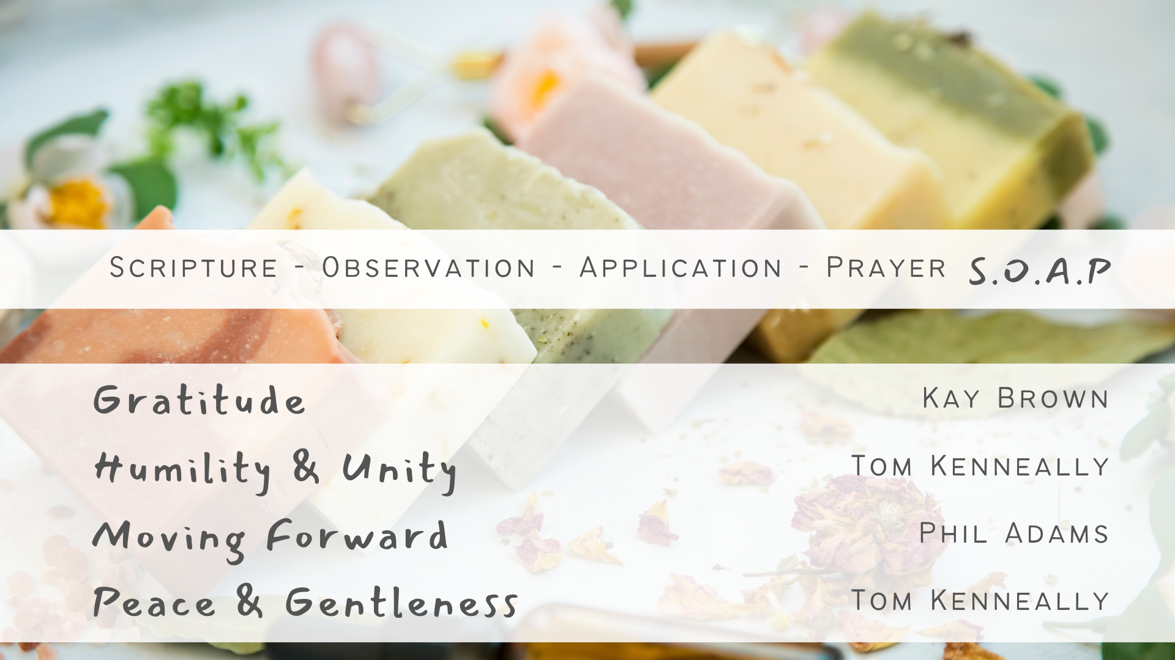

Slide 8
Scripture - Context
Paul is imprisoned while writing this, likely in Rome.
Paul knows a trial is coming soon, he doesn’t know if he will live.
Paul still writes with joy and gratitude
Main Themes: Stand firm in faith, live worthy of the Gospel, maintain humility and unity etc.

Slide 9
Scripture – Context
Paul’s tone changings to exhorting and practical instruction
Rejoice always, Virtue of Gentleness, Cultivating Peace through Prayer,

Slide 10
Observations
Paul has a strong emphasis on Joy/Rejoicing. He repeats it to emphasise its importance.
Start with Rejoicing! Contentedness can lead towards gentleness

Slide 11
Observations
We are called to Gentleness
“Strength under Control”
Anxiety Robs us of much including gentleness

Slide 12
Observations
Gentleness is an active choice and journey
We must force our minds on to positive things.

Slide 13
Applications
Choosing Joy in Every Circumstance
Embody Gentleness in Relationships
Prayerful surrender of Anxiety
Experience Gods peace
Mindful Focus on positive truths
Living out the Gospels

